Slide 1
STOCK MARKET PREDICTION USING MACHINE LEARNING TECHNIQUES
Guide Name Presented By
Vaheetha Salam Saritha H
Preethi.P.S

Slide 2
DESCRIPTION
Time series analysis and forecasting is of vital significance in stock market prediction.
Stock market forecasting involves uncovering the market trends with respect to time.
AIM
Develop new innovative approaches to foresee the stocks that result in high profits.

Slide 3
REQUIREMENTS
Front end : html,css,java script
Back end : python 3
Database :SQLite
IDE : PyCharm

Slide 4
DATA SETS
Tesla finance
Apple finance data
Google finance data
Walmart Finance data
Amazon finance data

Slide 5
STOCK MARKET
A “share market or equity market or a stock market'' is a public market that exists for issuing, buying and selling of stocks or shares
A Stock denotes a partial ownership in a company or an industry, with rights to share in its profits. A person, who invests in a stock or buys a stock of a company, is termed as stockholder of that company

Slide 6
About Our Work
A Stock Market Prediction Web App in Django using Quandl API and LinearRegression
Using Quandl API, we fetched stock market values from the date since the company is IPO.
The stock data is available till 27.03.2020.
Then from input number of days 'n' we take that number of days data as our Prediction data and rest is training data and apply Linear Regression model.

Slide 7
About Our Work
Suppose n=10, then data from 17.03.2020 to 27.03.2020 is our Prediction data and rest is training data. The accuracy most of the times is above 90%.

Slide 8
Dependencies
python==3.7.4
Django==2.2.5
numpy==1.17.2
pandas==0.25.1
Quandl==3.4.8
scikit-learn==0.21.3
DateTime==4.3

Slide 9
Dependencies
Pandas is a software library written for the Python programming language for data manipulation and analysis.
It offers data structures and operations for manipulating numerical tables and time series. It is free software
NumPy is a Python library used for working with arrays.
It also has functions for working in domain of linear algebra, fourier transform, and matrices.

Slide 10
Dependencies
Scikit-learn (formerly scikits.learn and also known as sklearn) is a free software machine learning library for the Python programming language.
It features various classification, regression and clustering algorithms including support vector machines, random forests, gradient boosting, k-means and DBSCAN, and is designed to interoperate with the Python numerical and scientific libraries NumPy and SciPy.

Slide 11
Dependencies
Quandl :Load Quandl Data Directly Into Python
Unifies financial and economic datasets from hundreds of publishers on a single user-friendly platform.
Most datasets on Quandl are available directly in Python, using the Quandl Python module

Slide 12
Dependencies
Getting financial data is amazingly easy with the Quandl Python module. For example,
import quandl
mydata = quandl.get("FRED/GDP")
The Quandl Python package is free to use and grants access to all free datasets. Users only pay to access Quandl’s premium data products.

Slide 13
WIKI data
The entire WIKI data feed is stored as a single table for faster and easy retrieval. Tables are a collection of data structured as one or more columns and rows
This data feed is updated at 9:15 PM ET every weekday.
It contain around 3200 companies data

Slide 14
Django
Django is a free and open source web application framework, written in Python.
A web framework is a set of components that helps you to develop websites faster and easier
Frameworks give you ready-made components to use.

Slide 15
MACHINE LEARNING ALGORITHMS
Linear regression
Autoregressive Integrated Moving Average Model(ARIMA)
Long short-term memory (LSTM) networks

Slide 16
1.LINEAR REGRESSION
Linear regression is perhaps one of the most well known and well understood algorithms in statistics and machine learning.
Analysis of two separate variables to define a single relationship and is a useful measure for technical and quantitative analysis in financial markets.
A model that assumes a linear relationship between the input variables (x) and the single output variable (y). More specifically, that y can be calculated from a linear combination of the input variables (x).
Here we take the Adj.Close price and find the forcasting.

Slide 17
1.LINEAR REGRESSION
Three major uses for regression analysis are (1) determining the strength of predictors, (2) forecasting an effect, and (3) trend forecasting.
Linear Regression is a machine learning algorithm based on supervised learning. It performs a regression task.
Regression models are target prediction value based on independent variables.
It is mostly used for finding out the relationship between variables and forecasting.

Slide 18
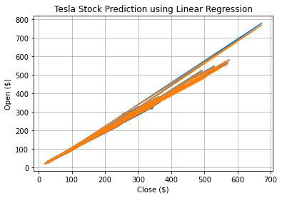
OUTPUT OF LINEAR REGRESSION

Slide 19
Advantages of LR
Linear Regression is simple to implement and easier to interpret the output coefficients.
When you know the relationship between the independent and dependent variable have a linear relationship, this algorithm is the best to use because of it’s less complexity to compared to other algorithms.
.

Slide 20
Disadvantages of LR
Linear Regression is a great tool to analyze the relationships among the variables but it isn’t recommended for most practical applications because it over-simplifies real-world problems by assuming a linear relationship among the variables.

Slide 21
ERROR RATE - MSE
MSE - Mean Square Error - It is the average of square of difference between the predicted values and true values. Sklearn provides it as a function.
The prediction error is the difference between the true value and the predicted value for an instance.
For Linear Regression MSE is : 4.17153862130235

Slide 22
2. ARIMA MODEL
ARIMA stands for “Auto-regressive Integrated Moving Average”
This model is also often called by the famous “Box-Jenkins model''.
A class of models that ‘explains’ a given time series based on its own past values
If a time series, has seasonal patterns, then you need to add seasonal terms and it becomes SARIMA
MSE on Test Data: 9727.384364152627

Slide 23
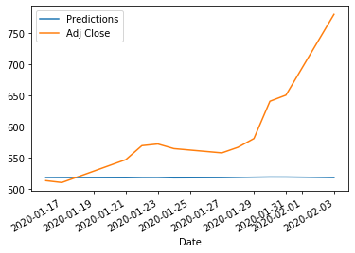
OUTPUT OF ARIMA MODEL

Slide 24
Disadvantage of arima model
Requires a stationary data series
Do not Consider the seasonal changes of time series data
The forecast is determined only by the past behavior of the variable.

Slide 25
3.LSTM
Long short-term memory (LSTM) is an artificiaL Recurrent Neural Network (RNN) architecture used in the field of deep learning.
We used "Tensorflow" as backend for the LSTM method
Advantages
First, it fails to store information for a longer period of time.
Second, there is no finer control over which part of the context needs to be carried forward and how much of the past needs to be ‘forgotten’.

Slide 26
Building the LSTM
In order to build the LSTM, we need to import a couple of modules from Keras:
Sequential - for initializing the neural network
Dense - for adding a densely connected neural network layer
LSTM - for adding the Long Short-Term Memory layer
Dropout - for adding dropout layers that prevent overfitting
MSE – 2.934235124954

Slide 27
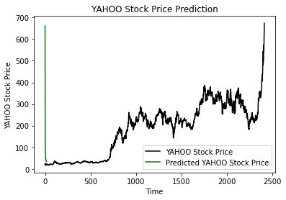
OUTPUT OF LSTM

Slide 28
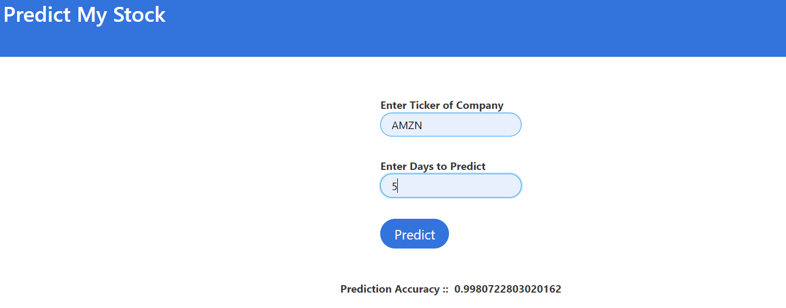
Final Result

Slide 29
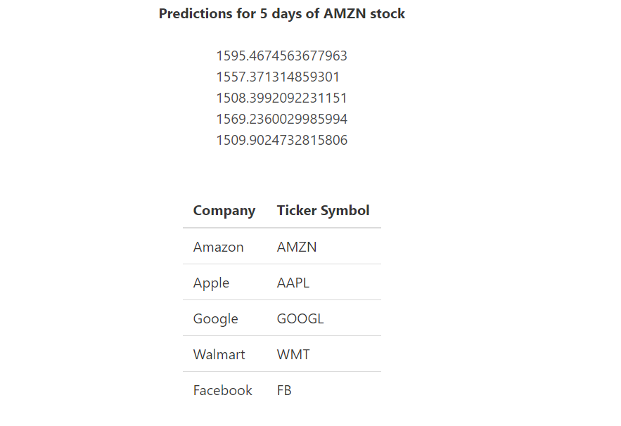
Final Result

Slide 30
THANK YOU!!

